Slide 1

Project Name - Harda Sports Club
Presented by Players

Slide 2
Meet us –
Palak Yadav (Leader maintain core coding part)
Chandan Rajput (Front Page Design and some coding part)
Khushi Rathore ( Logo Designer Forms Design )
Shravan Sharma (Content Provider And Image Selection )
Gaurav Malviya ( helps in every section)

Slide 3


To build this player we used :
Html
CSS
Canva for logo Design

Slide 4
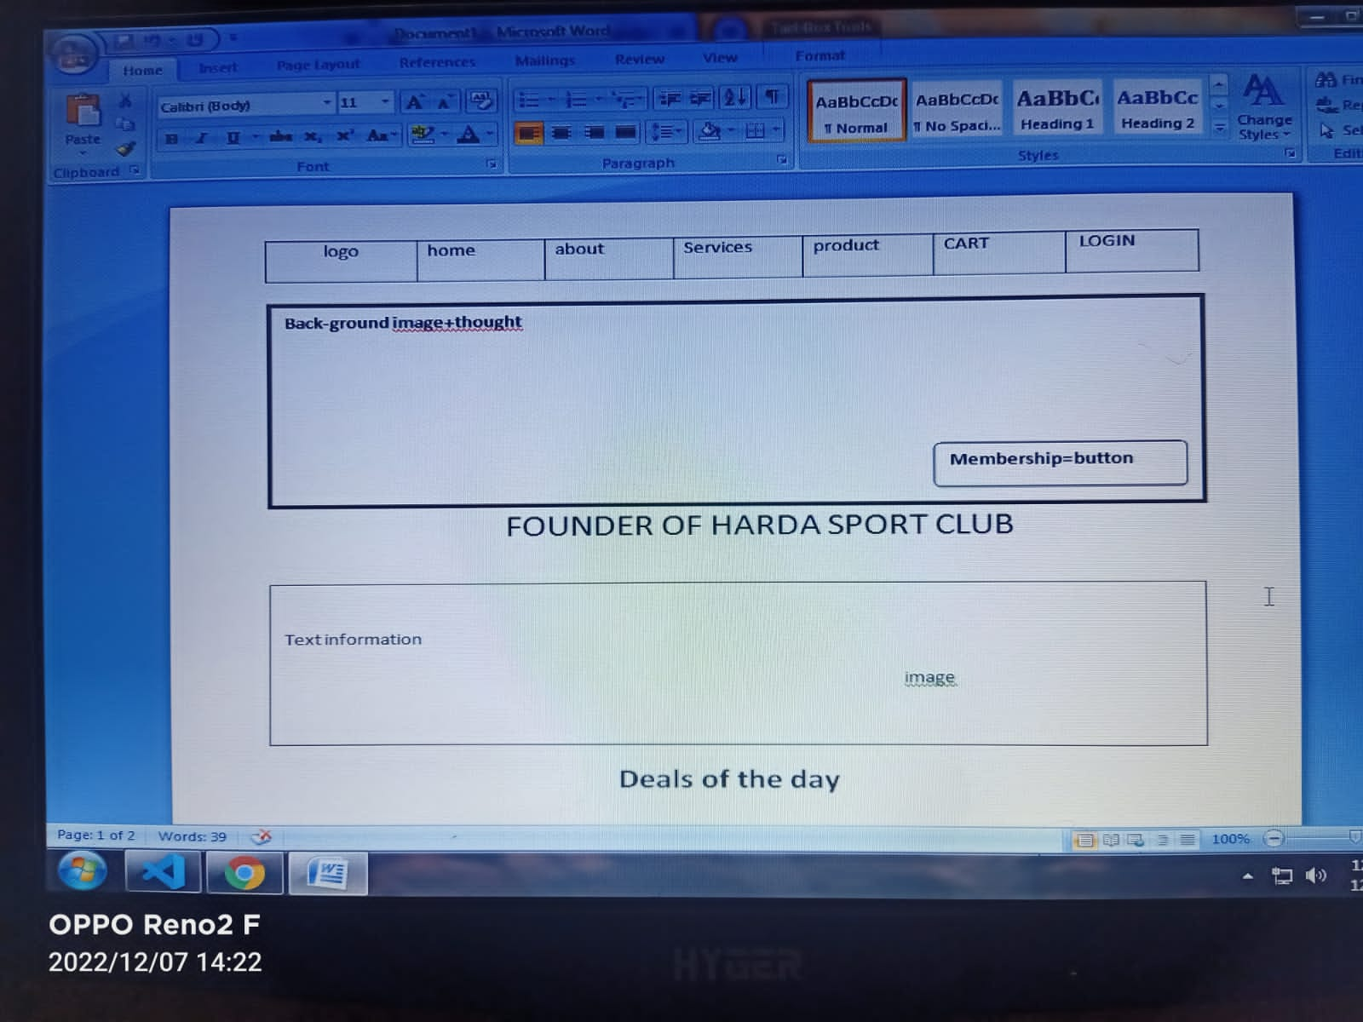
Wire Frame
1.

Slide 5
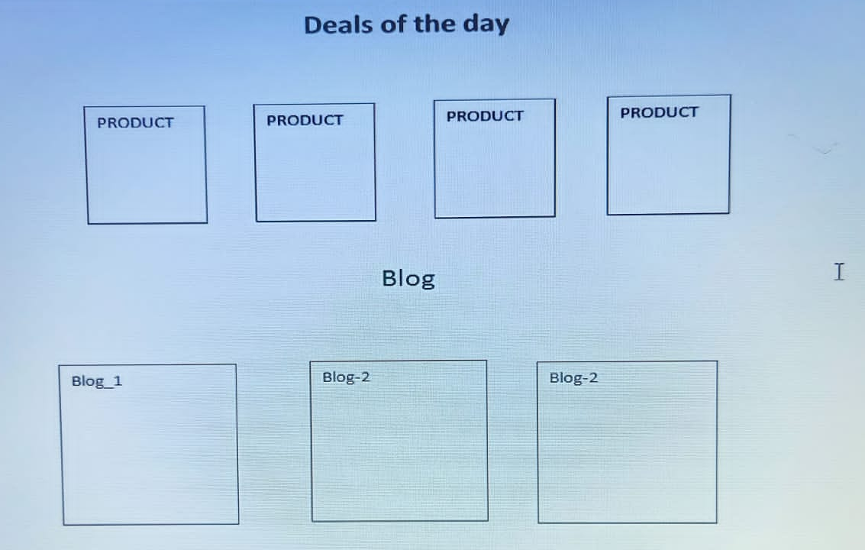
Wire Frame
2.

Slide 6
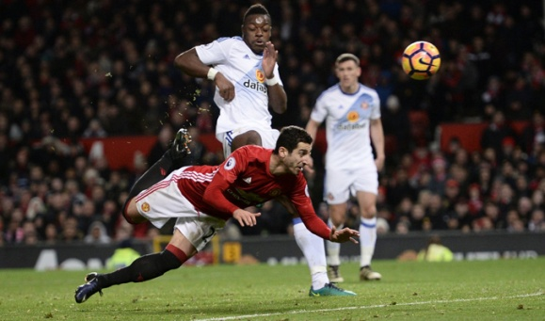
Summarizing this project
A club management project that provides and manages various club activities such as member registrations for various regular and vacations batches and more. the sports club website is based on html and css languages. It has also a product store which has many products and shop options

